Slide 1
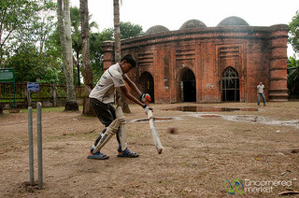
GOOD MORNING
And
WELCOME

Slide 2
INTRODUCTION
Class - Nine
Subject - English 1st
Unit - 02
Lesson - 01
BY
K. M. Hamidullah
Sutarpara High School;
Phulpur; Mymenshingh
ID - 27

Slide 3
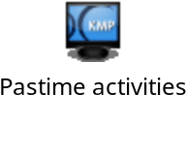
What do you guess about these activities?

Slide 4
Our lesson is on
“Pastime”
passing off-time with hobby or entertaining work(s)

Slide 5
After we have studied the Unit, we will be able to
Learning outcomes
Participate in conversation, discussion and debates.
Describe personal hobbies.
Choose the productive pastime in our real life.

Slide 6
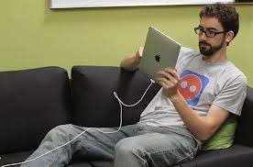
PRESENTATION
Look at each of the pictures

Slide 7
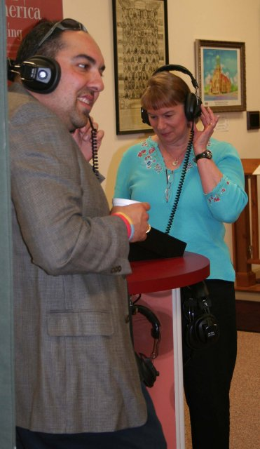
What are they doing ?
Listening to Music

Slide 8
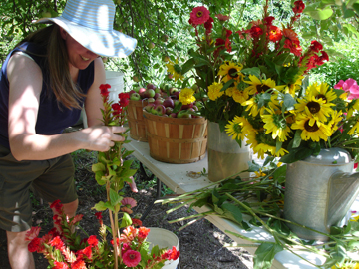
What is she doing?
Working in garden

Slide 9
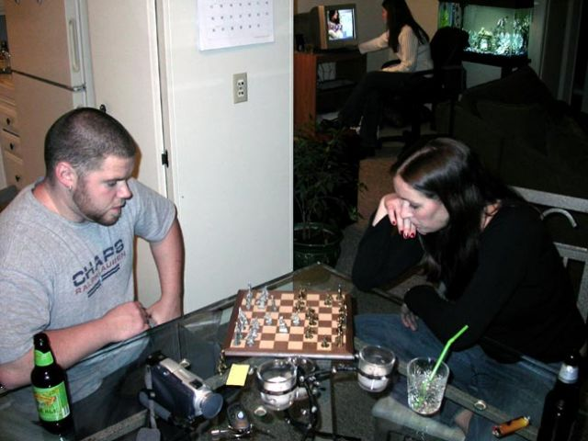
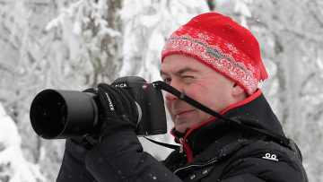
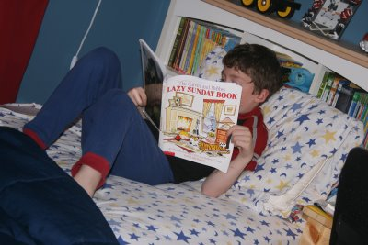
How are they passing their off-time?
By snap-shooting
By playing
By reading

Slide 10
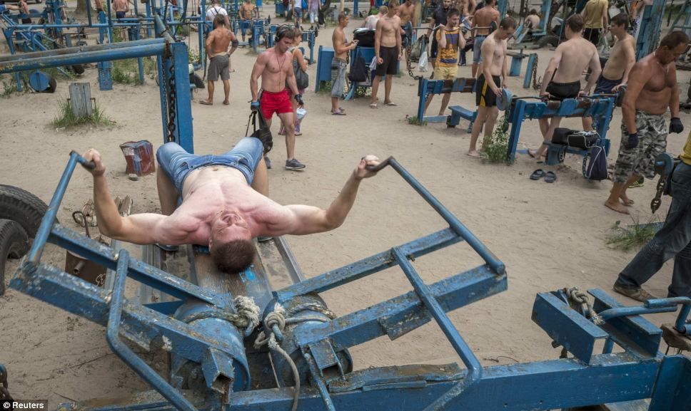
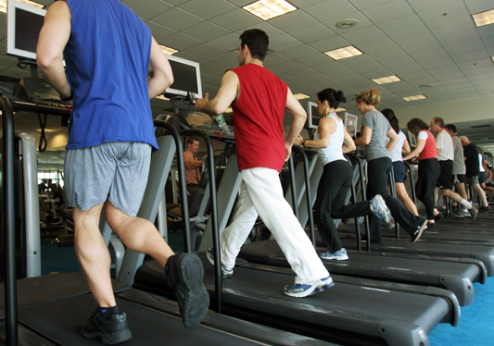
Take closer looks on these words as, ’gym’, ‘yoga’.
A place or big house designed or equipped for practicing physical exercise.(see below)
‘gym’

Slide 11
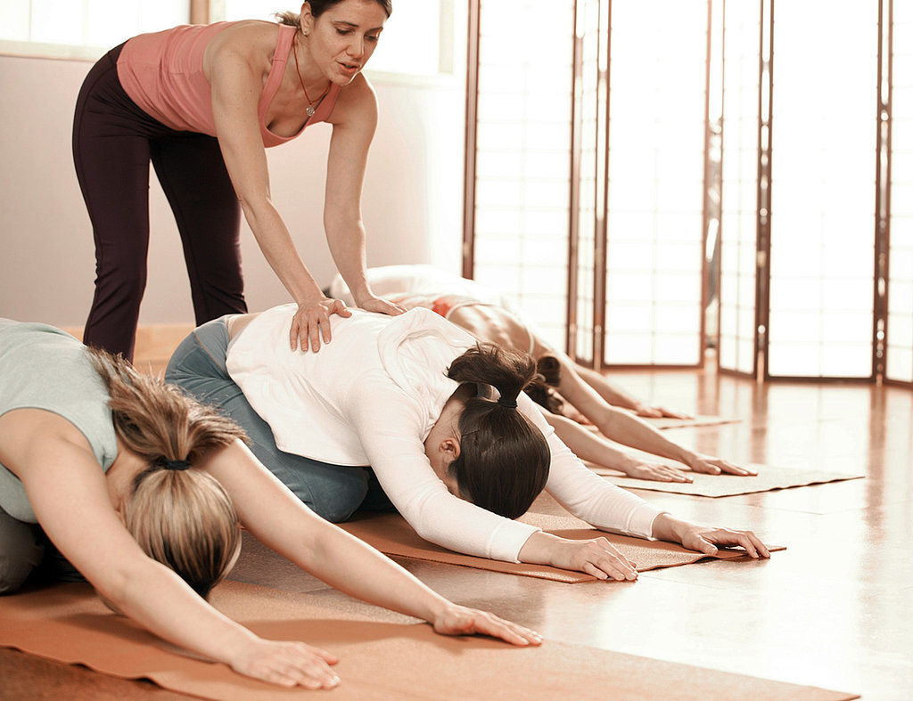
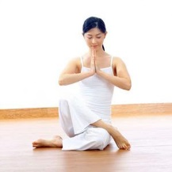
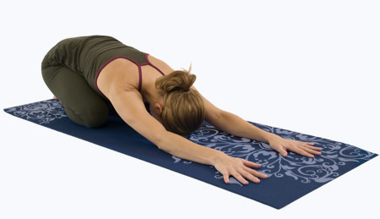
yoga
A type of exercise practiced making different postures. (see below)

Slide 12
10 min.
Read section ‘B’ and make two lists of Tiya’s and Anusha’s pastimes.
Match your answers
P a s t I m e s
Sl. No. | Anusha | Tiya
1. | Doing yoga | Watching TV
2. | Playing Chess | Listening to Music
3. | painting | Reading books and Magazines
4. | Reading book | Playing games on computer
5. | photography | Pot planting

Slide 13
Open your text book and read attentively section ‘C’ at page 16 and next section ‘ G’ at page 17.
Within 10 min.

Slide 14
Group Work
indications
Guess about the passage.
Discuss and share among you.

Slide 15
Pair work
Read the text in ‘G’.
Discuss it with your partner.

Slide 16
Evaluation
Work out section ‘E’ and ‘F’ in group.
Work out section ’G’ and ‘H’ in pairs.
Within 15 min.
Ask me if you likely need help.

Slide 17
HOME WORK
What are your pastime works?
How can your pastimes be productive?
Write a paragraph on your favourite pastime.

Slide 18
Ok
Best of luck
Good Bye

